Slide 1
TRansparent Interconnection of Lots of Links (TRILL) www.iol.unh.edu
March 11th 2010
David Bond
University of New Hampshire: InterOperability Laboratory

Slide 2
Routing vs. Bridging

Slide 3
Broadcast Domain

Slide 4
Broadcast Domain

Slide 5
Broadcast Domain

Slide 6
Broadcast Domain

Slide 7
Broadcast Domain

Slide 8
Broadcast Domain

Slide 9
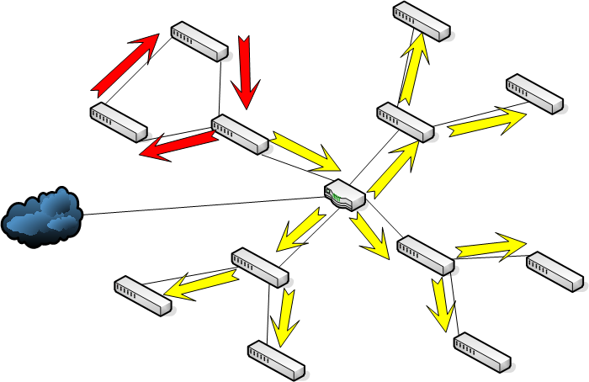
Broadcast Domain

Slide 10
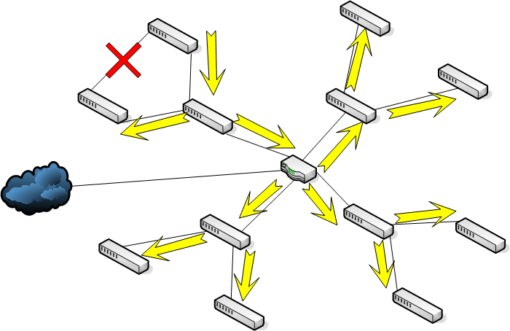
Spanning Tree

Slide 11
Spanning Tree

Slide 12
Spanning Tree

Slide 13
Spanning Tree

Slide 14
Spanning Tree

Slide 15
Spanning Tree

Slide 16
Spanning Tree

Slide 17
Spanning Tree
Prevents loops!
Zero configuration
Allows to redundant topologies
But! It shuts down links
Leads to traffic taking sub-optimal paths
Inefficient in Bandwidth utilization
Traffic Bottlenecks
Unacceptable for modern applications
Data Centers, Cloud Computing

Slide 19
Algorhyme
I think that I shall never see
a graph more lovely than a tree.
A tree whose crucial property
is loop-free connectivity.
A tree that must be sure to span
so packet can reach every LAN.
First, the root must be selected.
By ID, it is elected.
Least-cost paths from root are traced.
In the tree, these paths are placed.
A mesh is made by folks like me,
then bridges find a spanning tree.
Radia Perlman

Slide 20
Today
Problem Statement 
Solution
TRILL
Alternatives
SPB
Market Status
TRILL & the IOL
Research Opportunities

Slide 21
Algorhyme V2
I hope that we shall one day see
A graph more lovely than a tree.
A graph to boost efficiency
While still configuration-free.
A network where RBridges can
Route packets to their target LAN.
The paths they find, to our elation,
Are least cost paths to destination!
With packet hop counts we now see,
The network need not be loop-free!
RBridges work transparently,
Without a common spanning tree.
Ray Perlner

Slide 22
TRILL
IETF Working Group
BoF 2004
Draft Specification in IESG Last Call
Introduce Link State Routing to Layer 2
“The TRILL WG will design a solution for shortest-path frame routing in multi-hop IEEE 802.1-compliant Ethernet networks with arbitrary topologies, using an existing link-state routing protocol technology.”
This would solve our spanning tree problem

Slide 23
TRILL: Definitions
RBridge
Routing Bridge
Campus
A broadcast domain
Link State Routing Protocol
Creates a map of the network topology for each device
IS-IS
A link state routing protocol currently in use with IPv4 and IPv6

Slide 24
TRILL: Overview
Run the link state protocol, IS-IS
Gives each RBridge a network map
RBridges can receive four types of frames
Known Unicast
RBridge knows where the destination device is
Unknown Unicast
Multicast
Broadcast

Slide 25
TRILL: Overview
When an RBridge receives a frame it is the Ingress RBridge
The frame is coming into the RBridge Campus
The RBridge encapsulates this frame with a TRILL and Ethernet Header
Only one RBridge on a LAN encapsulates frames for that LAN
Appointed forwarder for that LAN
Selected by the designated RBridge

Slide 26
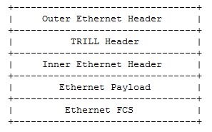
TRILL: Overview

Slide 27
TRILL: Overview
The four types of frames are handled in two different ways
Known Unicast
RBridge knows where the destination device is
It knows the “Egress RBridge”
The exit point from the Campus
Sends frame along shortest path route from Ingress RBridge to the Egress Rbridge

Slide 28
TRILL: Overview
Broadcast
Every device needs to see this frame
Send it to every LAN
Multicast
Many devices need to see this frame
Send it to every LAN
Optimization
Unknown Unicast
RBridge doesn’t know Egress RBridge
Send it to every LAN
All handled the same way
Sent over a distribution tree

Slide 29
TRILL: Distribution Trees
Distribution Tree
A minimal spanning tree over a network topology
Doesn’t this have the same disadvantages of STP?
Yes! But, these frames have to reach every link
No! We can have multiple distribution trees

Slide 30
TRILL: Distribution Trees
On Ingress into the campus set Egress RBridge to the root of a distribution tree
M bit signifies that the frame is being sent on a distribution tree

Slide 31
TRILL: Distribution Trees
Optimizations
Build multiple distribution trees
Campus wide number of trees to calculate is determined
If some device in the campus can only store one distribution tree in memory then only one distribution tree will be calculated
Send to distribution tree rooted near ingress RBridge
Load balance traffic over different distribution trees

Slide 32
TRILL: Address Learning
Review
Known Unicast
Takes Shortest Path from Ingress to Egress
Multicast/Broadcast
Sent over a nearby distribution tree
This is fine, everyone needs to see it anyways
Unknown Unicast
Sent over a distribution tree
This is undesirable, many LANs that don’t need the frame get the frame

Slide 33
TRILL: Address Learning
Solution 1: Minimize Unknown Unicast
When you see a frame, with Inner.Mac X from Ingress RBridge Y, memorize that tuple
Similar to MAC address learning in 802.3
Forget after a while
When two devices talk, first packet will be sent over a distribution tree, after that shortest path
Solution 2: Distribute Tuple Information

Slide 34
TRILL: ESADI
Solution 2: Distribute Tuple Information
ESADI: End Station Address Distribution Information
RBridges send End Station Address Tuples to other RBridges when they learn about them or are configured to send this information

Slide 35
TRILL: VLANs
VLANs
Layering of virtual broadcast domains over a single physical broadcast domain
Security, Traffic Engineering
TRILL works with VLANs
Layered on top of VLANs
One TRILL topology per VLAN

Slide 36
TRILL
Incremental Deployment
Agnostic to other protocol, a TRILL link can in fact be a 802.1Q-2005 Cloud of many switches
Security
No less secure than 802.1

Slide 38
Today
Problem Statement 
Solution 
TRILL 
Alternatives
SPB
Market Status
TRILL & the IOL
Research Opportunities

Slide 39
SPB
Shortest Path Bridging
802.1aq
IEEE’s solution to the same problem
Essentially form many spanning trees each rooted at a different node and send traffic on that spanning tree
Limited to 100 nodes(Zero Config SPBM), 1000 nodes (Managed SPBV), TRILL(64k)*
Portland

Slide 40
Market Status
802.1aq (SPB)
RFC 5556
TRILL: Problem and Applicability
RFC TBD
RBridges: Base Protocol Specification
In IESG Last Call
RBridge VLAN Mapping
RBridges: TRILL Header Options

Slide 41
TRILL & the IOL
Developing Testing Program
Interoperability Test Suite
Conformance Test Suite
Plug Fest Q3/Q4 2010
Research! (CS majors!)

Slide 42
Research Opportunities
What is the optimal number of distribution trees in an arbitrary campus?
What is the optimal placement of the roots of these distribution trees?
TRILL runs over “a single Level 1 IS-IS area”, what would be the effect of multiple levels or instances
Working Group wants to know the answer to this!
Load balancing mechanism?

Slide 43
THE END!
Problem Statement 
Solution 
TRILL 
Alternatives 
SPB 
Market Status 
TRILL & the IOL 
Research Opportunities 

Slide 44
References
http://www.ietf.org/dyn/wg/charter/trill-charter.html
http://www.ietf.org/id/draft-ietf-trill-rbridge-options-00.txt
http://www.ietf.org/id/draft-ietf-trill-rbridge-vlan-mapping-01.txt
http://www.ietf.org/id/draft-ietf-trill-rbridge-protocol-16.txt
http://www.ietf.org/rfc/rfc5556.txt

